Slide 1

Industrial Training Seminar
on
“Python Programming Project”
Presented By:
Name of Candidate: Ritik Agarwal
University Roll No.: 24EJCIT158
Branch/Class/Section: IT/B.Tech/C
Submitted To:
Mr. Asharam Gurjar
Assistant Professor
Department of IT

Slide 2
Introduction/Abstract
I am Ritik Agarwal (Roll No. 24EJCIT158), a B.Tech student in Information Technology at Jaipur Engineering College and Research Centre (JECRC), Jaipur.
I completed a 4-week industrial training in Python Programming at CodSoft from 25/07/2025 to 25/08/2025. The training focused on hands-on learning of Python basics, building logic, and developing small projects. During this time, I learned Python syntax, libraries, and various problem-solving techniques, which improved my technical skills.
As part of the training, I created a mini project: a Rock-Paper-Scissors Game in Python, which helped me apply programming concepts to real tasks.

Slide 3
Company/Organization Details
CodSoft is an IT services and product-based company that delivers software development, training, and solutions in emerging technologies. It provides a platform for students and professionals to enhance their technical knowledge, improve problem-solving skills, and gain exposure to real-world projects.
Through its internship and training programs, CodSoft emphasizes hands-on learning by assigning practical tasks and industry-oriented projects. Its vision is to bridge the gap between academic knowledge and industry needs, while also nurturing talent in fields like web development, artificial intelligence, data science, automation, and application development.

Slide 4
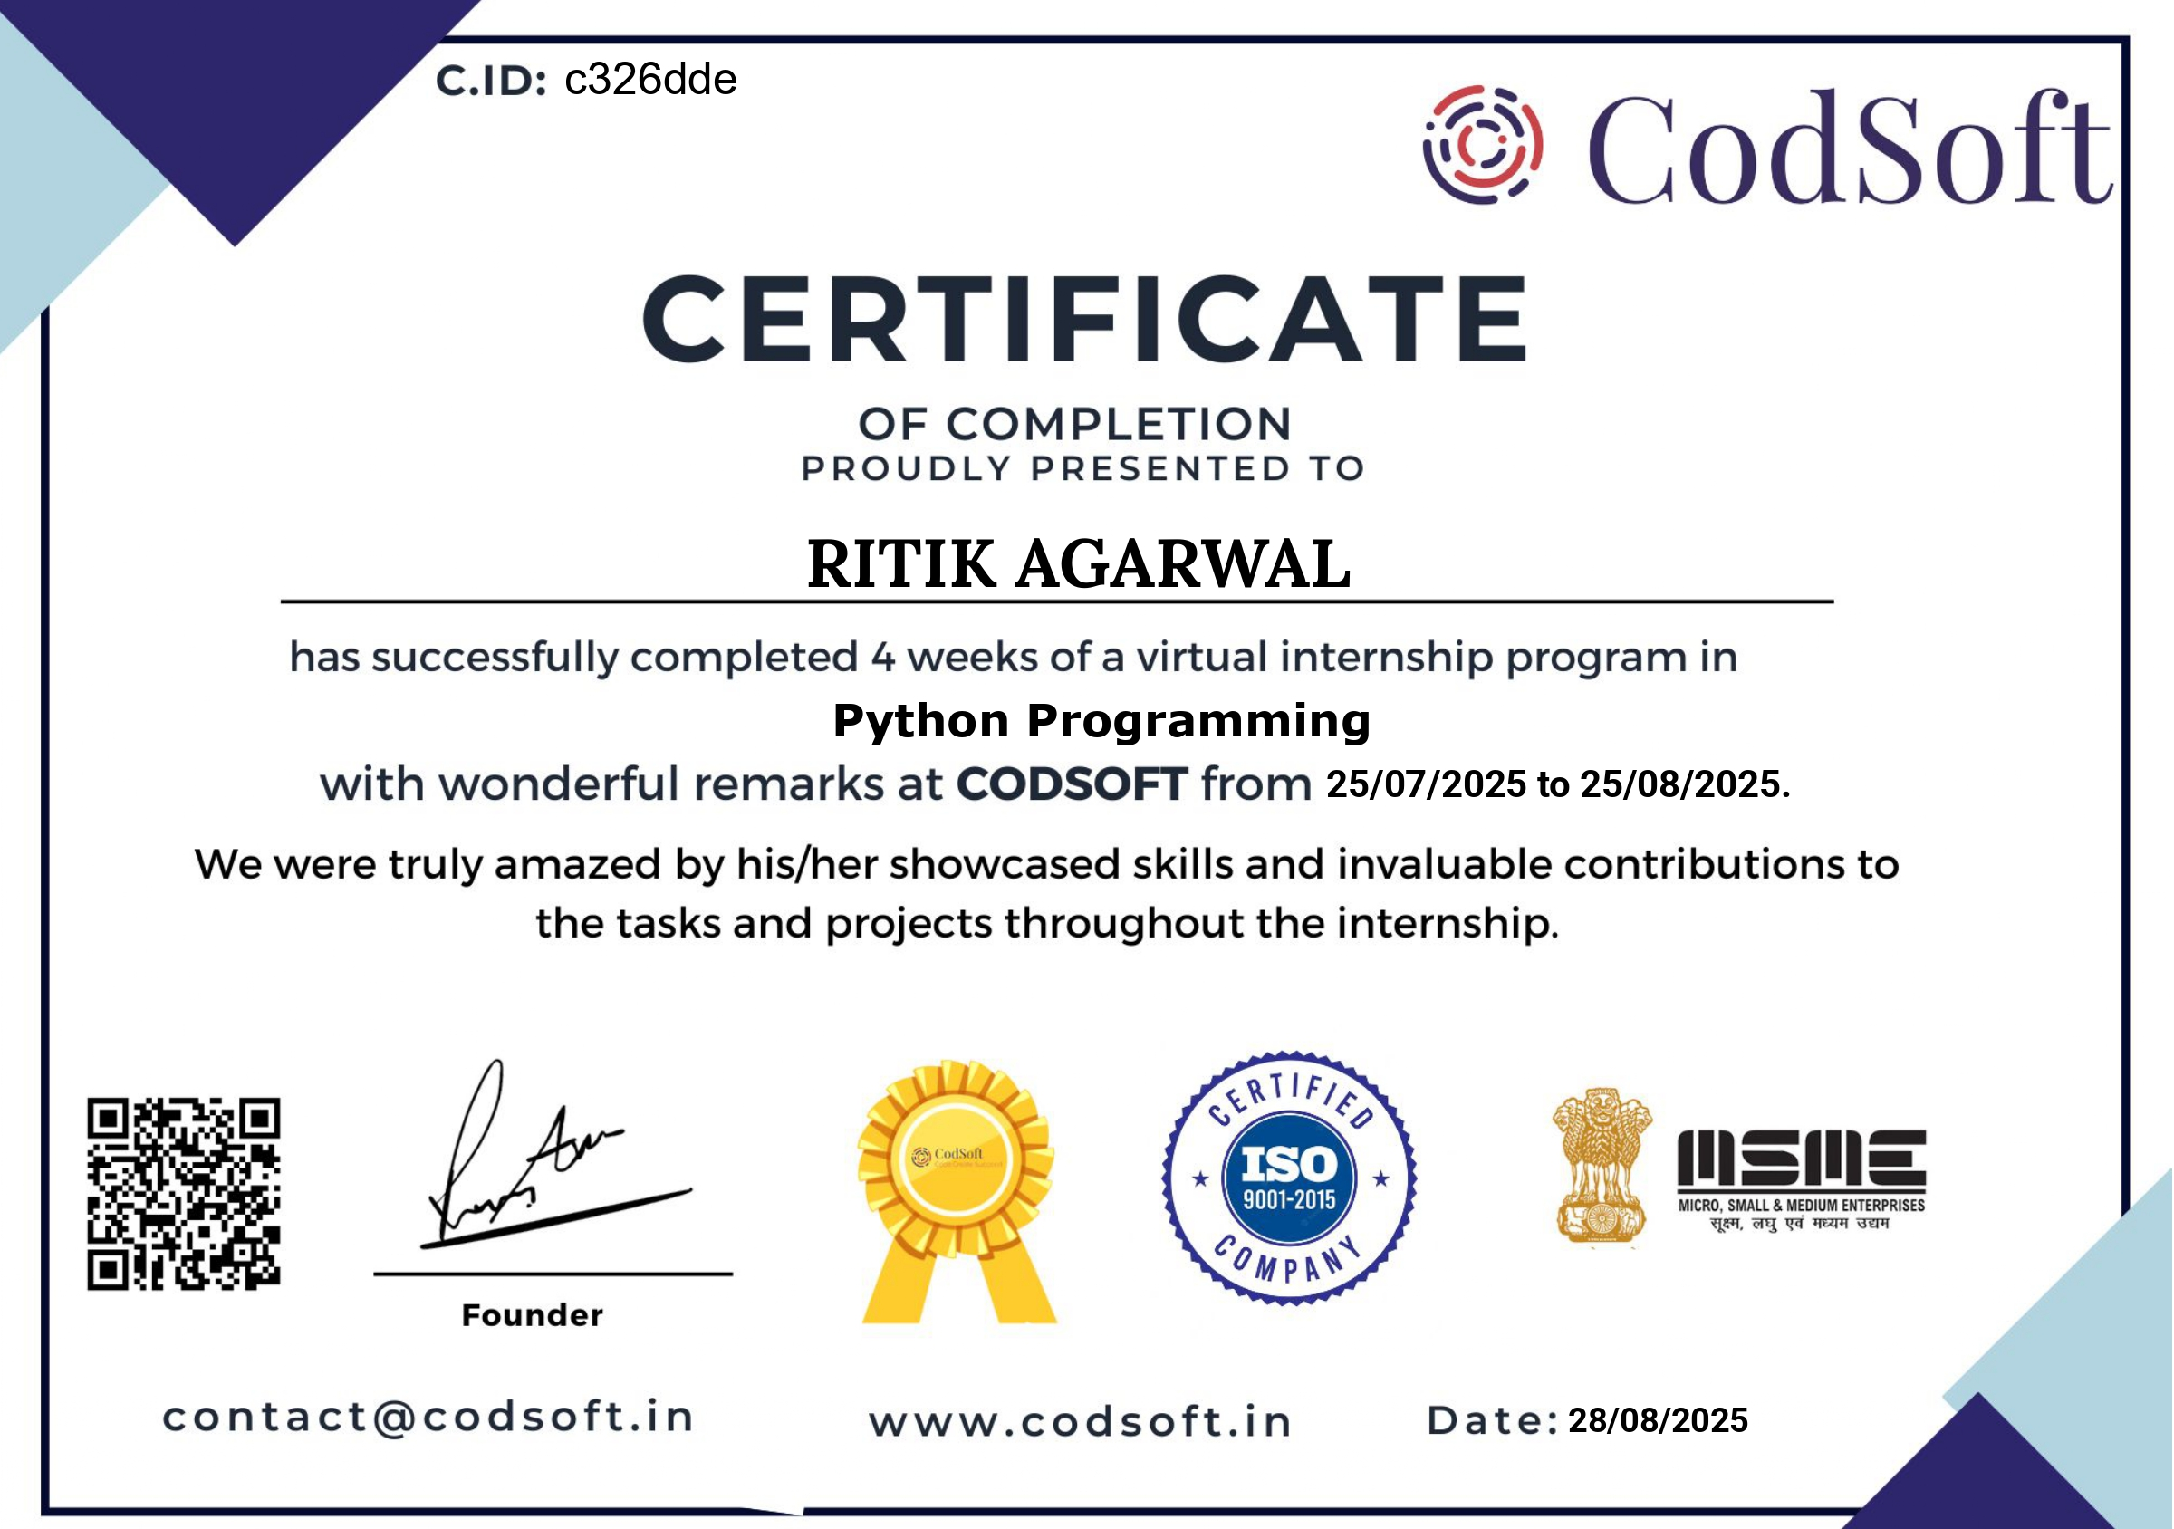
Certificate

Slide 5
Technology Name - Detailed Description
Python is a high-level, interpreted, and object-oriented programming language known for its simplicity and readability. It lets developers focus more on solving problems instead of dealing with complex syntax. This makes it one of the most popular programming languages today.
Key Features:
1. Simple and easy to learn. It is beginner-friendly with clean and readable syntax.
2. Rich standard library. It provides built-in modules for everyday tasks like file handling, math, and networking.
3. Cross-platform support. It works on Windows, Linux, and macOS.
4. Supports OOP and functional programming. It enables modular, reusable, and efficient code.

Slide 6
Overview of Tools Used
Tools Used:-
Python 3: This is the programming language for the project. It offers simplicity and strong libraries.
Editor: VS Code, PyCharm. These are user-friendly IDEs. They feature syntax highlighting, debugging, and extensions to make development easier.
Library: “random” This is a Python standard library module. It generates random choices for the computer in the Rock-Paper-Scissors game.
Operating System: Windows, Linux. The project can run on multiple platforms. This shows Python’s ability to work across different systems.

Slide 7
Project Description
Objective:
To create an interactive Python game that lets a user play Rock-Paper-Scissors against the computer. This project shows how to handle input, use conditional statements, and implement randomization in Python.
Features:
1. Accepts user input (r, p, s) for Rock, Paper, or Scissors.
2. The computer makes a random choice using Python’s random library.
3. Conditional logic is used to determine the outcome: Win, Lose, or Draw.
4. Offers a simple text-based interface for easy interaction.

Slide 8
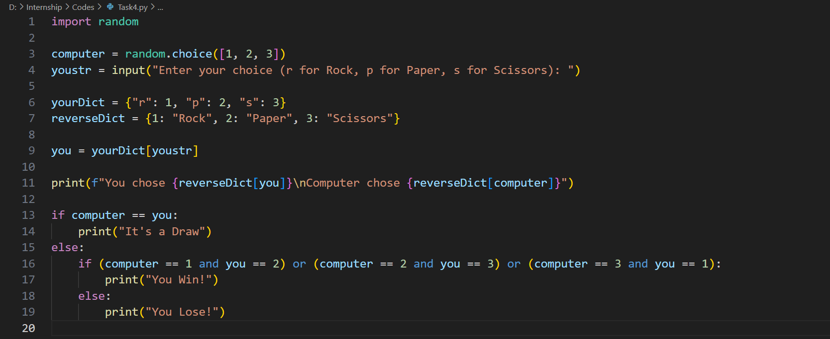
Screenshots of Project(Code)

Slide 9
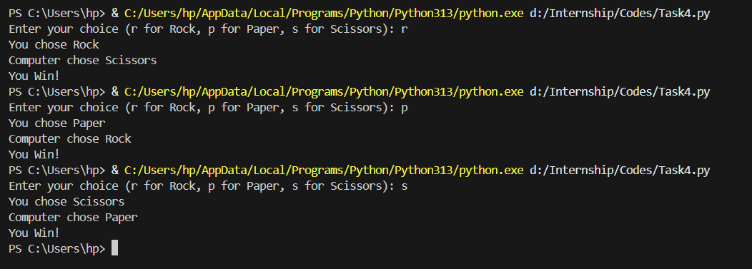
Screenshots of Project(Output)

Slide 10
Conclusion
1. The project showed how to use basic Python features, such as input handling, conditional statements, and the random module.
2. It offered a straightforward way to apply programming logic in a small real-world application.
3. Creating the Rock-Paper-Scissors game boosted my problem-solving skills, coding efficiency, and logical thinking.
4. The project gave me practical experience in building interactive programs, connecting theoretical ideas with real-world use.
5. Overall, the internship and project built my confidence in Python programming and got me ready for more complex applications.

Slide 11
Future Scope
The Rock-Paper-Scissors project can be improved and expanded in several ways:
1. Graphical User Interface (GUI): Create a more engaging interface using PyGame for better user interaction.
2. Score Tracking System: Keep and show player scores across multiple rounds to improve the gameplay experience.
3. Multiplayer/Online Version: Expand the game for two players or connect it with an online platform for real-time matches.
4. Advanced Python Applications: Use this foundation to look into projects in AI, Machine Learning, Web Development, and Automation.

Slide 12
References
CodSoft – Internship Offer Letter and Certificate (2025).
CodSoft – Industrial Training Write-up on Python Programming (2025).
Python Software Foundation – Python 3 Documentation. Available at: https://docs.python.org/3/
W3Schools – Python Tutorial. Available at: https://www.w3schools.com/python/
GeeksforGeeks – Python Programming Basics. Available at: https://www.geeksforgeeks.org/python-programming-language/

Slide 13
THANK YOU

